Slide 1
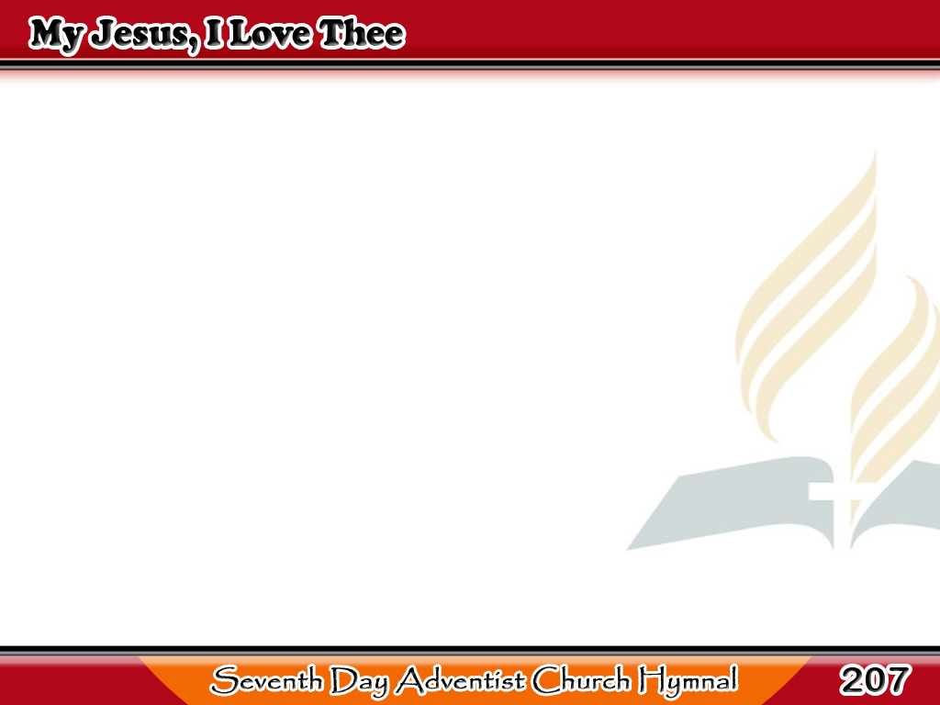
Jesus, Mahal Kita
My Jesus, I love Thee,
I know Thou art mine;
For Thee all the follies
of sin I resign;
1/4

Slide 2
Jesus, Mahal Kita
My gracious Redeemer,
my Savior art thou;
If ever I loved Thee,
my Jesus, ‘tis now.
1/4

Slide 3
Jesus, Mahal Kita
I love Thee because
Thou hast first loved me,
And purchased my pardon
on Calvary’s tree;
2/4

Slide 4
Jesus, Mahal Kita
I love Thee for wearing
the thorns on Thy brow;
If ever I loved Thee,
my Jesus, ‘tis now.
2/4

Slide 5
Jesus, Mahal Kita
I’ll love Thee in life,
I will love Thee ‘til death,
And praise Thee as long as
Thou lendest me breath;
3/4

Slide 6
Jesus, Mahal Kita
And say when the death
dew lies cold on my brow,
If ever I loved Thee,
my Jesus, ‘tis now.
3/4

Slide 7
Jesus, Mahal Kita
In mansions of glory
and endless delight,
I’ll ever adore Thee
in heaven so bright;
4/4

Slide 8
Jesus, Mahal Kita
I’ll sing with the glittering
crown on my brow,
If ever I loved Thee,
my Jesus, ‘tis now.
4/4

